Slide 1




Smart City Hackathon
Submission Template

Slide 2
TEAM NAME
Raghava Moorthy.R Gowshikan.S Kishore.C Ganesh Ram.R
THEME:
Pollution Reduction

Slide 3
Problem Statement
Define the exact PROBLEM that you intend to solve.
Try to reduce pollution from vehicles.
Pollution from vehicles will cause global warming,and it cause many ill effects to the people who
Were in urban areas.People who live in many cities will have lung problems and cancer due to this
pollution.

Slide 4
Solution
Try to reduce these pollution by planting trees. Other than trees try to use HEPA(High-Efficiency particle arrestor) air filters In our vehicles that reduce the pollution by filtering many unwanted and harmful particulate matter
If we use Hepa filters in our vehicles will reduce the pollution in upcoming years to live a healthy life
Hepa filters contains an inbuild carbon filters.
Carbon filters will trap excess carbon and the precipitate can be converted to black carbon paint or ink and that can be salable

Slide 5
Technical Stack Description
Hepa filters were made of borosilicate glass fibre or plastic fibres which binds upto 5% of acrylic binder.
A hepa filters will designed to trap small particles and will the particles larger than the pore will get trapped
Key factors affecting its functions are: fiber diameter, filter thickness, and face velocity. A HEPA filter is specifically designed to target much smaller pollutants and particles that become trapped to fibers. These air filters are normally between 0.5 and 2.0 micrometers.
In this covid times HEPA will also reduce the spread of covid particles through air .

Slide 6
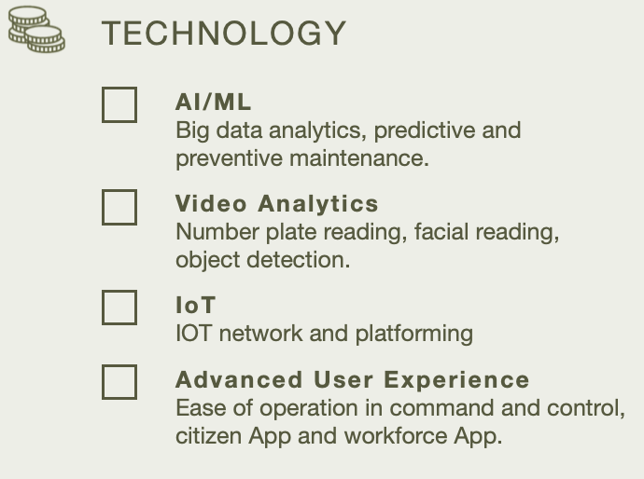
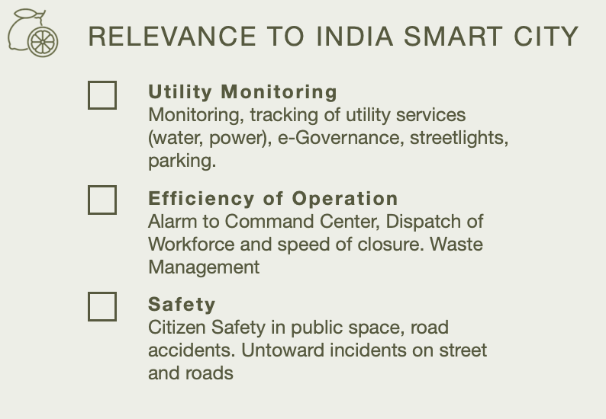

Slide 7
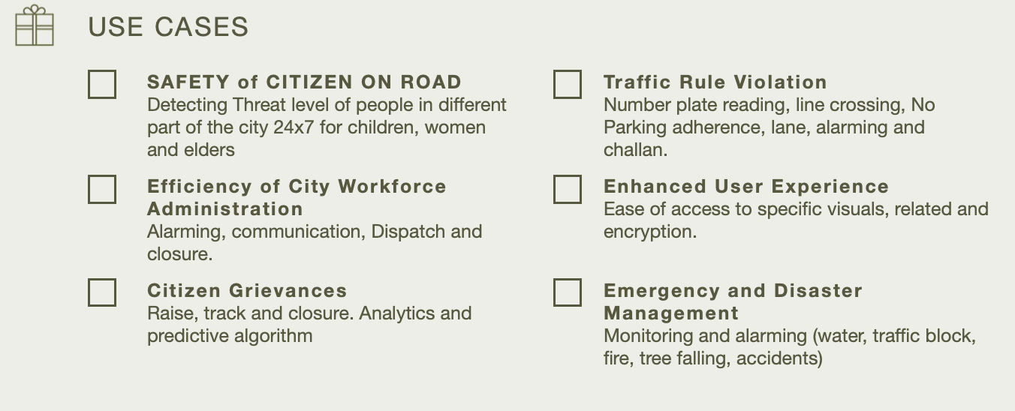

Slide 8
What’s next for your proposed solution?
Try to implements the HEPA filters in all types of vehicles in the upcoming years to reduce the deaths caused due to vehicle pollution and any resipirative hardness by these pollution.

